Slide 1
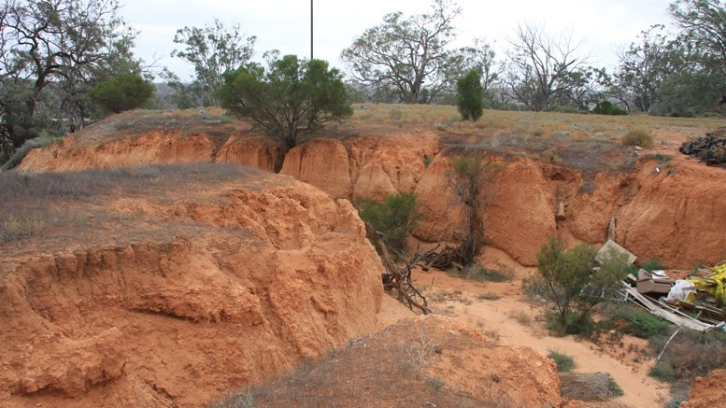
3D Mapping of depth to sodicity constraint for cropping across the Murray-Darling Basin
Pozza, L.E. ^{1,} *, Filippi, P. ¹, Haan, S.², Scalzo, R.^{4,5}, Jones, E^{.1}, Odeh, I.O.A^{.1}, Triantafilis, J.³, Whelan, B. ¹, Bishop, T.F.A¹
¹ Sydney Institute of Agriculture, School of Life and Environmental Sciences, The University of Sydney, NSW, Australia
² Sydney Informatics Hub, The University of Sydney, NSW, Australia
³ Manaaki Whenua – Landcare Research, Lincoln, New Zealand
⁴ School of Mathematics & Statistics, University of Sydney ⁵ ARC ITTC in Data Analytics for Resources and the Environment (DARE)
Notes:
If your abstract is accepted as an oral presentation you will have 15 minutes to present including question and answer time (12+3minutes).

Slide 2
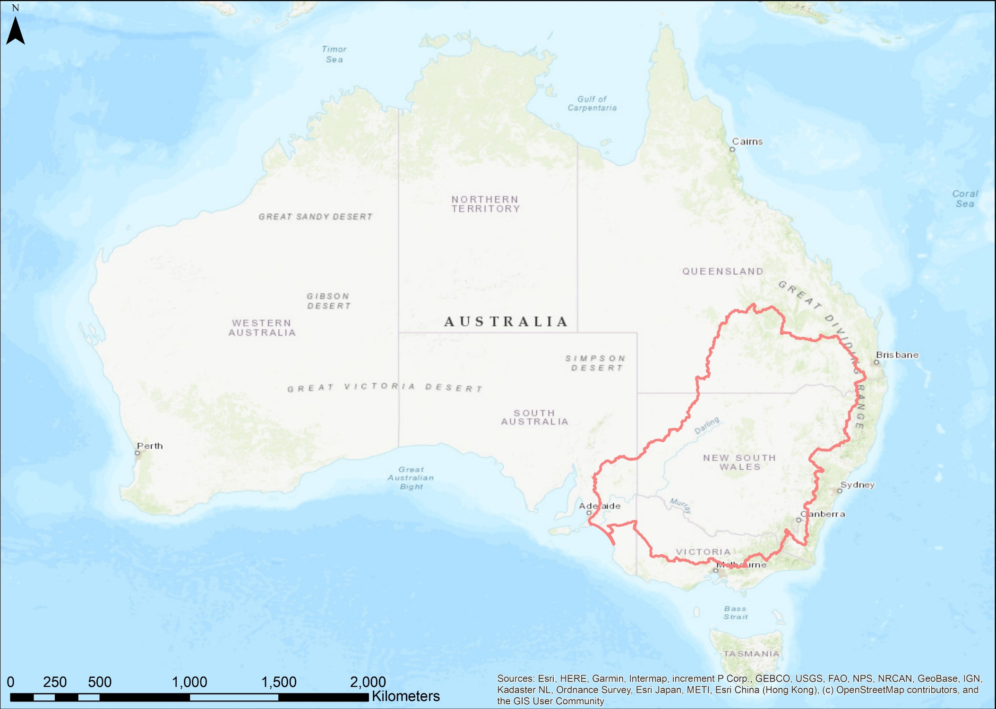
The Murray-Darling Basin
Soil types of the Murray-Darling Basin
Front image: https://www.flickr.com/photos/shandydownunder/4607822047/sizes/c/
Notes:
Approx. 1,059,000 km² (ABS,2015)
$24 billion food and fibre annually(MDBA, 2020)
Soils + cropping suitability
Range of different soil types→ highlight in image but mention broad characteristics
Vertosols (25%), Calcarosols (14%), Kandosols (13%), Sodosols (11%), and Rudosols (10%)
Because of these characteristics of the soils, sodicity is an issue across the basin

Slide 3
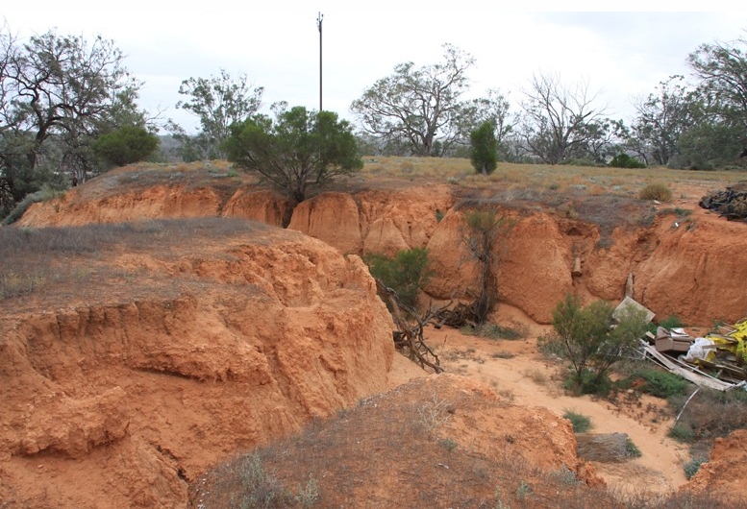
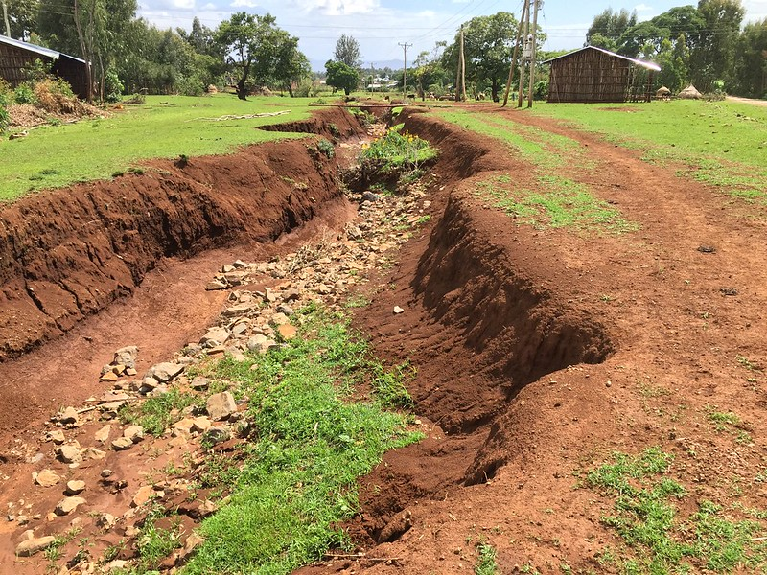
What on Earth is Sodicity?
Excess Na⁺ on clay particles
→ Dispersion upon wetting
Structural collapse
→ Reduced porosity & oxygen diffusion
Root growth limited
→ Reduced access to nutrients & water
https://www.flickr.com/photos/shandydownunder/4607822047/sizes/c/
Restricted crop growth potential and yields
Photo credit: Katrina Charles/REACH; via Flickr; www.reachwater.org.uk
Notes:
Hazelton what do all the numbers m,ean?
Severe surface crusting
Low infiltration and hydraulic cond
Hard and dense subsoils
High susceptibility to gully erosion
High susceptibility to tunnel erosion

Slide 4
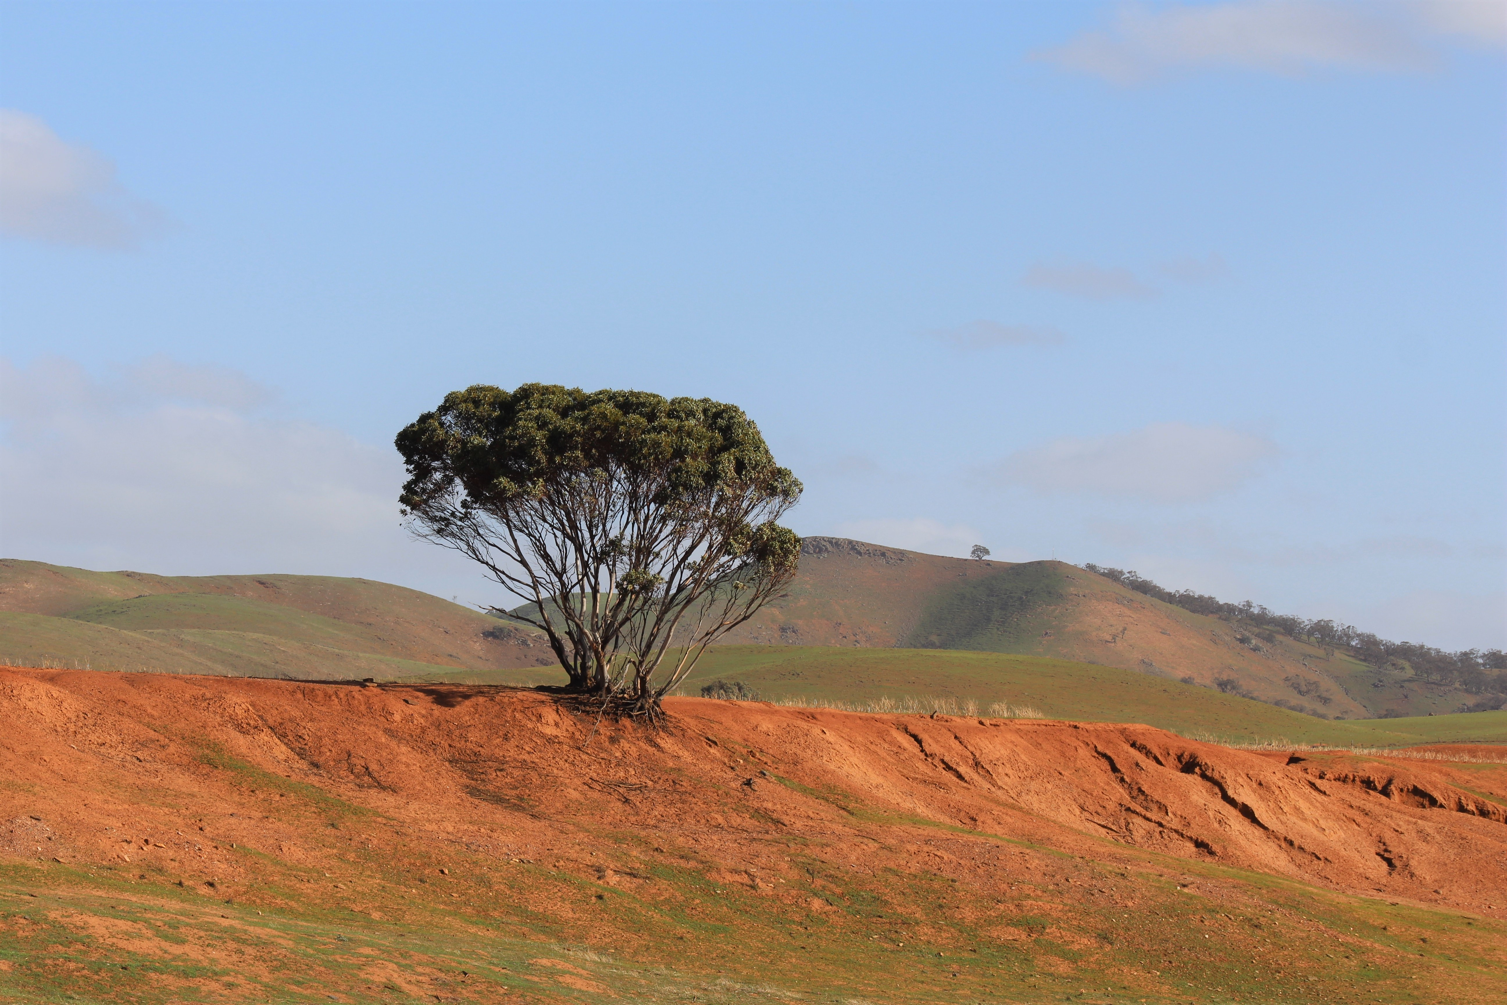
Understanding Sodicity
Exchangeable Sodium Percentage (ESP)
Relationship with other soil properties
Salinity (EC), pH, texture (Hazelton and Murphy, 2016)
Boundaries (Filippi et al., 2020)
≥ 6% = Sodic
10% = Marginally sodic
15% = Strongly sodic
Management depends on conditions (Hall et al. 2021)
Photo by Charles G on Unsplash
Notes:
High ESP associated with high pH – other cations are precipitated out, leaving more na remaining
Some cases ok if left undisturbed
Soil amendments – lime or gypsum
Adaptation – land use change, tolerant crops
Adding lime of gypsum decreases ESP
Relationship with other soil properties ~ impact on plants
Management for sodic soils varies depending on conditions
Filippi 2020 – ESP paper
where a soil is considered sodic if the ESP exceeds 6% according to the Australian Soil Classification (ASC) (Isbell 2016). In contrast, the majority of overseas classification systems (e.g. Soil Taxonomy and World Reference Base) consider a soil to be sodic if the ESP exceeds 15% (Soil Survey Staff 1999; IUSS Working Group WRB 2014). While an ESP of 6% is considered sodic by the ASC, 234 an ESP of 10 or 15% is more likely to start to inhibit rooting depth in certain soil types (e.g. Vertosols). An 235 ESP of 15% is also the threshold value for sodic in the Soil Taxonomy and World Reference Base 236 classification systems.
impacted by a variety of factors, such as crop type, weather, management, and in particular, other soil properties. For example, the electrical conductivity (EC) of soil, and the EC of irrigation water impacts on whether a sodic soil will disperse (McNeal 1968), 446 which has a considerable effect on crop root growth. The texture of a soil also has a strong impact on this. 447

Slide 5





Where is the Sodicity?
Soil survey
Can become expensive and time consuming
Limited samples = limited picture
Modelling can be used to fill in the gaps
Modelling and Mapping
Accuracy
Depends on the information you have available
Can make use of freely available data
Notes:
Why do we make maps? To understand the spatial distribution, to visualise patterns
Always working to produce more accurate predictions, currently latest is by incorporating other variables which may be linked with the variable we are studying

Slide 6
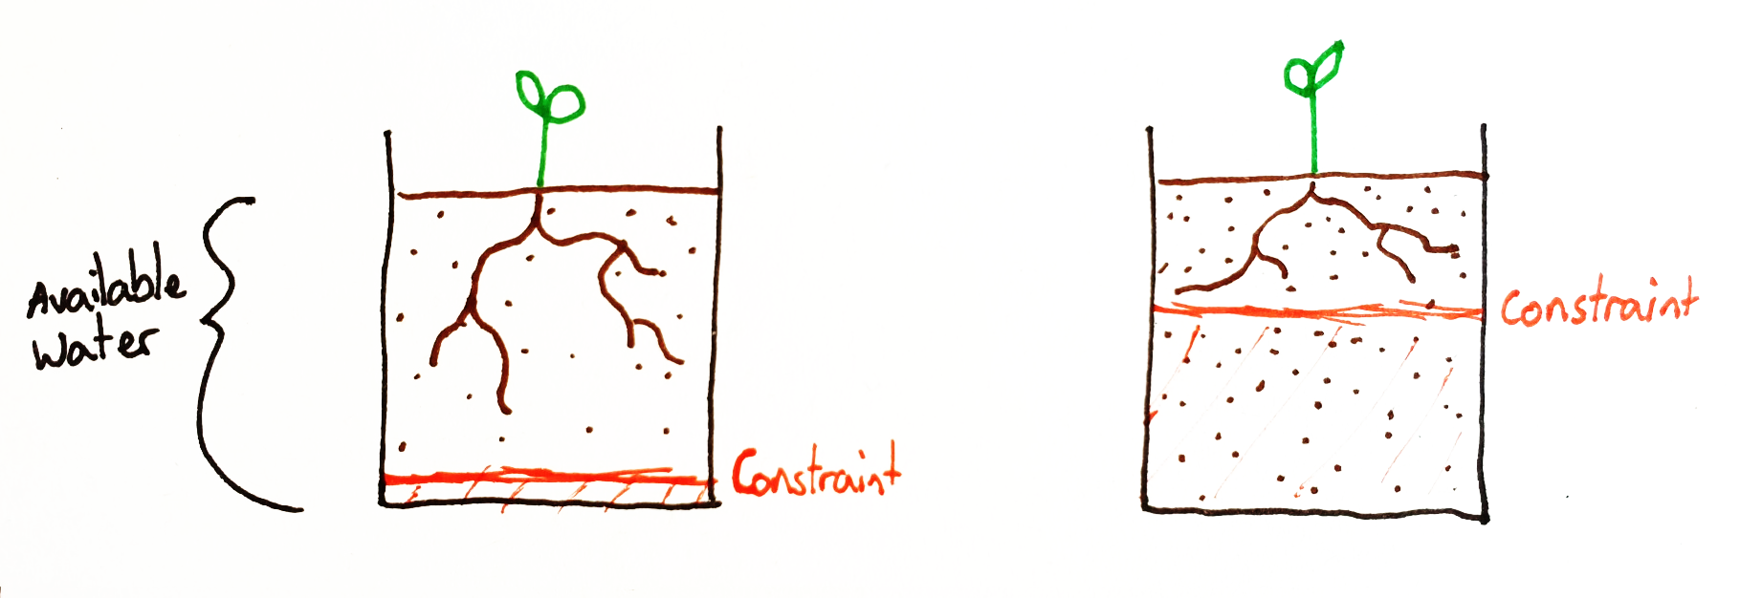
Depth to cropping constraint
Key: Where to apply management?
→ Surface + at depth
Need a product which is easier for end users to interpret than current products
Map of depth to which a cropping constraint is met
Notes:
Map of depth to which a constraint is met
Simple
Inform other properties – e.g. AWC
= 3D interpretation of where sodicity is occurring at a level that can influence crop growth and yield

Slide 7
Aims
Map of depth to which a cropping constraint is met = 3D interpretation of where sodicity is occurring at a level that can influence crop growth and yield
How?
Freely available data → soil surveys + remote sensing information
Machine learning
Finer resolution than currently available
Vertical and horizontal mapping

Slide 8
Modelling and mapping process
Vertical information
Splines from soil survey data
Horizontal information
Soil survey + Remote sensing data
Random Forest
10-fold CV
Model prediction
30m covariate grid, 10cm depth intervals
Depth to which cropping constraint is met
Calculated from predictions for each depth
Notes:
Blue + pink = data, purple = process, yellow = output

Slide 9
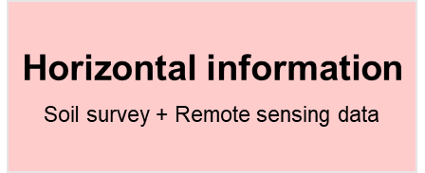
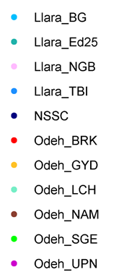
Horizontal information
9
Soil survey data = response
Different datasets
University of Sydney (“Llara_”, “Odeh_”)
n = 858
National Soil Site Collation (NSSC) (Searle, 2014)
n = 5,467
Survey
Notes:
Variety of soil data sources, NSSC itself is a collated dataset.
Excellent we have all of this data – will better inform the model, but with so many different surveys we would expect increase in error despite harmonisation
Years sampled: 1924-2020

Slide 10
Horizontal information
Soil survey data cleaning
NSSC = soil data from many different surveys
Different protocols, different recording
Even with intensive cleaning and harmonization, weird things still happening
e.g. multiple observations for a single site and depth
1.5% vs 60%
10 observations for single site and depth
Excluded observations where ESP > 40%
Harder to know what is ‘real’
Possibly stemming from different CEC calculation
Survey
Notes:
200 samples lost after cleaning
Variety of soil data sources, NSSC itself is a collated dataset.
Excellent we have all of this data – will better inform the model, but with so many different surveys we would expect increase in error despite harmonisation
ESP is proportion of sodium present within the total exchangeable cations present in the soil sample (CEC), some have incorporated different cations in the calculations

Slide 11
Horizontal information
Covariate data
Group | Name | Temporal resolution | Spatial resolution | Source
Remote sensing | NDVI 50th percentile | Jan 2000 – Dec 2019 | 30 m | Landsat 7, Google Earth Engine
 | Red Band, 50th percentile | Jan 2000 – Dec 2019 | 30 m | Landsat 7, Google Earth Engine
 | Radiometrics – K, U, Th (%) | Broad, compiled 2019 | 100 m | Geoscience Australia
Terrain attributes | Elevation (m) | 2000 | 30 m | Geoscience Australia
 | Slope (Degrees), Aspect | 2000 | 30 m | CSIRO Data Access Portal
 | MrRTF, MrVBF | 2000 | 30 m | CSIRO Data Access Portal
Soil | Soil type (ASC dominant soil order) | “Best of”, compiled 2012 | 250 m | ASRIS, CSIRO Land & Water
Geology | Silica index (%) |  | 1:250,000 | Gray et al (2016)
Climate | Rainfall (mm) | 1976-2005 | 1 km | ANUCLIM
 | Temperature (°C) | 1976-2005 | 1km | ANUCLIM
Notes:
Link these to process which fit into ESP → provide reasoning as to why you have included within the model
A lot of these are linked with soil formation,
NDVI- vegetation – what is there, what is not, shows what grows well, what not and potentially the soil colour associated with bare soil imagery (Red band more)
Terrain – linked to certain soil forming
Soil types – different soils have different physicochem properties
Geology ~ parent material forming these soils, releasing cations into the soil

Slide 12

Vertical information
Covariate: Mid-depth
Range of sample depths + intervals
Depth restricted to 1m
Uniform depth intervals needed
→ Equal Area Quadratic smoothing splines (Bishop et al. 1999; 211 Malone et al. 2009)
10cm intervals
Mid point of each derived depth interval used in model
Notes:
Note example here – 0-10 cm spline, but then used the middle depth for this

Slide 13

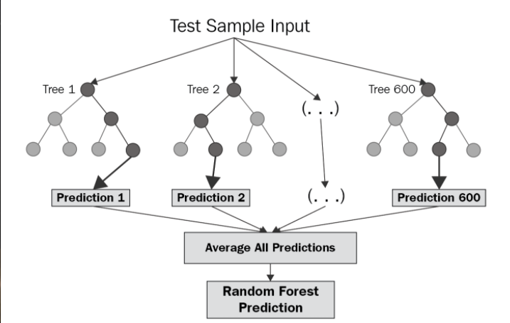
Random Forest
10-fold Cross-validation
Folds derived using CLHS based on coordinates and average ESP at each profile location
Subset | r² | LCCC | RMSE | Bias
Calibration | 0.974 | 0.985 | 1.477 | 0.007
Validation | 0.589 | 0.729 | 5.656 | -0.0214
Image source: https://levelup.gitconnected.com/random-forest-regression-209c0f354c84

Slide 14
Random Forest
Variable Importance
How much each covariate has contributed to the model
Does not tell us about relationship between response and covariate
Non-‘important’ covariates could be highly related to response
→ Unwise to simplify model based on Importance score

Slide 15
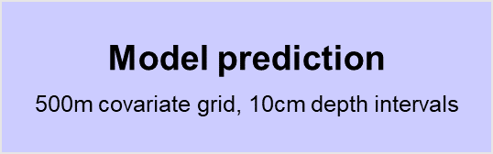
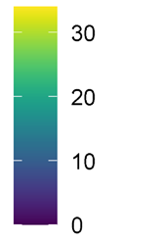
Model prediction – ESP at depth
10cm depth
30 cm depth
60 cm depth
ESP %
Notes:
Blue = low, yellow = high. Gets slightly lighter, with higher ESP up north & in southwest. From these maps we can calculate the depth at which a chosen constraint is met

Slide 16
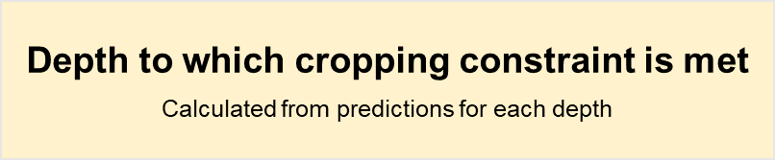
Depth to which ESP constraint is met
10cm depth
10% ESP
15% ESP
6% ESP
Depth (cm)
>100
Notes:
Good we have this, but also need an idea of how much we can trust the map. We have an idea of the accuracy, but this is a single value which represents our overall estimates
Also important to have an understanding of the uncertainty, and produce something which gives us more of an applied understanding of whether we can understand predictions in a certain area → there is not consistently 5% error occurring across the entire area. Single value is good, but need something more
Therefore by mapping a measure of the uncertainty in the form of how likely each pixel is to exceed the threshold, we are able to have more of an idea of whether the site is really exceeding the threshold or not…
Need to put this into better words

Slide 17
How precise is our model?
Random Forest
→ Retain all 500 predictions
15% ESP
Does each prediction exceed threshold?
Depth (cm)
>100
Yes
Value = 1
No
Value = 0
Calculate mean of binary values
Probability of exceeding set threshold
Notes:
We have a measure of accuracy, but also need a measure of precision (uncertainty)
Idea: finding out range of possible values predicted by the model
Although our Model accuracy is low, the RMSE (7%) is a single value which does not apply to every single pixel. It is therefore also important to obtain an idea of model precision; can do this by using the raw tree predictions
Detail how this is done
Prob of exceedance approximated whats goin on in ppaddock

Slide 18
Probability of exceeding threshold
Threshold = 15% ESP
10cm depth
30cm depth
60cm depth
Probability
Notes:
So for each depth we can calculate the proportion of each pixel exceeding the threshold.
T 10 cm it is actually unlikely at most locations that ESP 15% is met in profile, likelihood increases deeper within the profile
Although our Model accuracy is low, the RMSE (7%) is a single value which does not apply to every single pixel. It is therefore also important to obtain an idea of model precision; can do this by using the raw tree predictions
Detail how this is done
Prob of exceedance approximated whats goin on in ppaddock

Slide 19
Conclusions
Good news…
Can produce the map – accuracy not the best, but starting point
Single product, easier to interpret
Finer resolution
Bad news…
Model is not optimal, so need to explore further…
Currently making huge extrapolations
Notes:
→ BUT the computational issues are manageable as once we have a polished product, the University can run/rerun. Key audience is consultants, institutions and government, will help inform farmers.
New methods out there, currently on a par with each other [ref], so may be something we are missing, or alternative approach is needed
→ Can fit model to any data, but needs to make sense (Wadoux paper Alex;s face)
- some areas predicted better than others as some regions have not been sampled

Slide 20
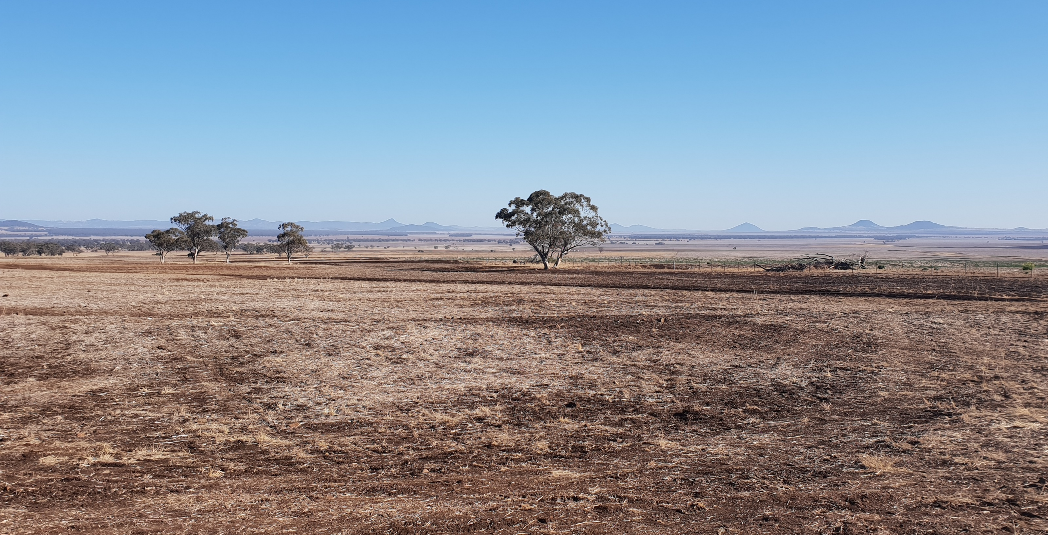
Moving forward
After some fine tuning, we aim to release a 30m product of depth to constraint, probability of exceeding threshold.
Are all covariates contributing to the model, or just adding noise?
Recursive Feature Elimination (Guyon et al 2002)
Improvement in model algorithm and process
Increment Averaged Kriging (Orton 2016, Orton 2020)
Gaussian Processes
Should we be mapping where we don’t have points?
Integrate Area of Applicability (Meyer and Pebesma, 2020)
Move beyond ESP – ECe, pH…
Notes:
GP – as Tom mentioned today, provides a measure of the uncertainty
IAK3d – reason why selected?

Slide 21
References
Australian Bureau of Statistics, 2015, Feature Article: Murray-Darling Basin, retrieved:18/06/21, from https://www.abs.gov.au/AUSSTATS/abs@.nsf/Lookup/1301.0Chapter3042009%E2%80%9310
Bureau of Meteorology (BOM), 2013, Australian Water Resources Assessment 2012, The Bureau of Meterology, Melbourne, Australia. http://www.bom.gov.au/water/awra/2012/documents/assessment-lr.pdf
Bishop, T.F.A.; McBratney, A.B.; Laslett, G.M. Modelling soil attribute depth functions with equal-area quadratic smoothing splines. Geoderma 1999, 91, 27–45
CSIRO Land & Water, 2012, ASRIS Australian Soil Classification - Dominant Soil Order (250m raster), http://www.asris.csiro.au
Filippi, P., Jones, E.J., Bishop, T.F.A., 2020. Catchment-scale 3D mapping of depth to soil sodicity constraints through combining public and on-farm soil databases – A potential tool for on-farm management. Geoderma 374, 114396. https://doi.org/10.1016/j.geoderma.2020.114396
Gallant, J., Wilson, N., Dowling, T., Read, A., Inskeep, C. 2011. SRTM-derived 1 Second Digital Elevation Models Version 1.0. Record 1. Geoscience Australia, Canberra. http://pid.geoscience.gov.au/dataset/ga/72759
Gray, J., 2017. Digital soil mapping of key soil properties over NSW, The state of NSW and office of environment and heritage.
Hall, D., Overheu, T., Lemon, J., 2021. Managing dispersive (sodic) soils. Department of Primary Industries and Regional Development's Agriculture and Food division, Retrieved: 27/06/21 from https://www.agric.wa.gov.au/dispersive-and-sodic-soils/managing-dispersive-sodic-soils
Guyon, I., Weston, J., Barnhill, S. & Vapnik, V. 2002. Gene selection for cancer classification using support vector machines. Machine learning, 46, 389–422.
Malone, B.P.; McBratney, A.B.; Minasny, B.; Laslett, G.M. Mapping continuous depth functions of soil carbon storage and available water capacity. Geoderma 2009, 154, 138–152
Meyer, H., Pebesma, E., 2020. Predicting into unknown space? Estimating the area of applicability of spatial prediction models 1–21. https://doi.org/10.1111/2041-210x.13650
Murray-Darling Basin Authority (MDBA), 2020. The Murray-Darling Basin and water management fact sheet. Retrieved:18/06/21 from https://www.mdba.gov.au/sites/default/files/pubs/The-murray-darling-basin-and-water-management-fact-sheet.pdf
Orton, T.G., Pringle, M.J., Bishop, T.F.A., 2016. A one-step approach for modelling and mapping soil properties based on profile data sampled over varying depth intervals. Geoderma 262, 174–186. https://doi.org/10.1016/j.geoderma.2015.08.013
Orton, T.G., Pringle, M.J., Bishop, T.F.A., Menzies, N.W., Dang, Y.P., 2020. Increment-averaged kriging for 3-D modelling and mapping soil properties: Combining machine learning and geostatistical methods. Geoderma 361, 114094. https://doi.org/10.1016/j.geoderma.2019.114094
Poudjom Djomani, Y., Minty, B.R.S. 2019a. Radiometric Grid of Australia (Radmap) v4 2019 unfiltered pct potassium. Geoscience Australia, eCat reference number 131978. http://dx.doi.org/10.26186/5dd4a7851e8db
Searle, R., 2014. The Australian site data collation to support the GlobalSoilMap. In: Arrouays, D., McKenzie, N., Hempel, J., Richer de Forges, A.C., McBratney, A.B. (Eds.), GlobalSoilMap: Basis of the Global Spatial Soil Information System. CRC Press Taylor & Francis Group, Boca Raton, pp. 127–132.
Wilford, J.R., Kroll, A. Complete Radiometric Grid of Australia (Radmap) v4 2019 with modelled infill. Geoscience Australia, Canberra. http://pid.geoscience.gov.au/dataset/ga/144413

